Slide 1
Study Unit 5 Data Analytics in Python

Slide 2
Introduction to Scikit-Learn

Slide 3
Scikit-Learn
It is common to use Python to carry out tasks for data analytics, statistical modelling or machine learning recently.
One of the most common libraries used for these purposes is scikit-learn, a free machine learning library written for Python.
Scikit-learn features various algorithms such as classification, regression, clustering, etc.
In machine learning, programs are constructed with parameters such that they can “learn” from newly fed data.
Programs can automatically adjust and improve their behaviour according to the new “knowledge”.

Slide 4
Algorithms in Scikit-Learn
Here are some common algorithms available in scikit-learn:
Supervised learning
Linear Models | Gaussian Processes
Discriminant Analysis | Cross decomposition
Kernel ridge regression | Decision Trees
Support Vector Machines | Isotonic regression
Nearest Neighbours | Neural network models (supervised)
Unsupervised learning
Gaussian mixture models | Novelty and Outlier Detection
Clustering | Density Estimation
Covariance estimation | Neural network models (unsupervised)

Slide 5
Install and Import Scikit-Learn
Use the import syntax to load scikit-learn into the program.
It is sklearn and not scikit-learn that refers to the scikit-learn library.
import sklearn

Slide 6
Import Algorithms from Scikit-Learn
Since the library is extensive, programmers usually only load the required algorithm or only its “estimator” object.
For instance, if linear regression models are required, import the estimator LinearRegression from the module linear_model by:
It is not unusual to load multiple algorithms for one analytics task.
Put sufficient comments in the program to explain the purpose and use of each imported module.
from sklearn.linear_model import LinearRegression

Slide 7
Activity
Import the following algorithms of scikit-learn into your JupyterLab notebook:
train_test_split
metrics
pre-processing
tree
Module “KMeans” from “cluster”
Module “PCA” from “decomposition”

Slide 8
Data Preparation for Analytics Algorithms

Slide 9
Specify and Remove Missing Values
We can define specific strings (e.g., strings with white space ("") as missing values during the import process of a DataFrame using read_csv().
One way to deal with missing values is to remove those rows with any missing value from the DataFrame completely.
DataFrame_name = pd.read_csv("csv_file_name.csv", na_values = "na_string", na_filer = True/False)
DataFrame_name.dropna(axis = 0, how = "any"/"all")

Slide 10
Replace Missing Values
Alternatively, we can choose to replace missing values of an entire DataFrame or a particular column by specific values.
Different variable types may require different treatments of missing values.
DataFrame_name.fillna(value = repl_value)
DataFrame_name["column_label"].fillna(value = repl_value)

Slide 11
Reduce Number of Categories
Categorical variables may need to be treated in data analytics.
Usually, they are converted to dummy variables required by some algorithms.
Example: Weight of {Normal, Overweight, Obese} can become two dummy variables of Overweight with either 0 or 1; and Obese with either 0 or 1. Here, 0 means No, 1 means Yes.
Sometimes to reduce the number of categories to simplify the problem.
Example: Grade {Fail, Subpass, Pass} can become {Fail, Pass}
In Python, we can replace category labels by the .replace() method:
DataFrame_Name["column_label"].replace(to_replace, value)

Slide 12
Discretisation
If a categorical variable has ordered numeric values as categories, we can discretise them into new bins by the cut() function.
The cut() function only includes the rightmost edge in each bin and not the leftmost one.
Put the highest value of each category in the list of x. Start the list with -1 in case 0 also belongs to the original categories, or 0 otherwise.
DF_Name["column"] = pd.cut(x = array, bins, labels)

Slide 13
Select Variables
Some variables may not be relevant to the analysis
Example: Name is not useful for predicting Income
These variables should be removed from the DataFrame before applying the scikit-learn estimator.
Use the attributes .iloc() and .loc() to select the necessary columns.

Slide 14
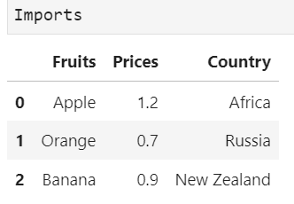
Using iloc vs loc for Selection (I)
Suppose we only need Fruits and Prices from the Imports dataset

Slide 15
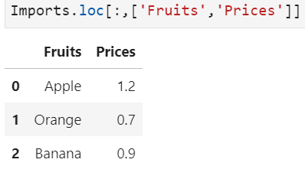
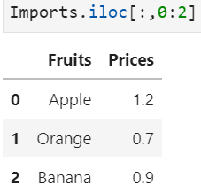
Using iloc vs loc for Selection (II)
loc: we specify the variable labels ‘Fruits’, ‘Prices’
Iloc: we specify column indices 0:2 after the comma

Slide 16
Rename Variables
Use the .rename() method to rename the variables in a DataFrame.
The column labels to be renamed must be put as keys of a dictionary.
The values of the dictionary will be the new labels of the corresponding columns.
DF_Name["column"].rename(columns = {"oldvar": "newvar"})

Slide 17
Create Dummy Variables
Categorical variables must be converted to dummy variables before included in the scikit-learn algorithms.
Dummy variables only have two values: 0 and 1.
If an observation belongs to a certain category, the corresponding dummy variable will be 1, otherwise 0.
Use get_dummies() to convert categorical variables to dummy variables.
You can use .astype() to change a numeric categorical variable to “category”, “str” or “object” before converting it to dummy variables.
DF_name["column"] = pd.get_dummies(data, drop_first)
DF_name.astype({"var_name": "type_str", …})

Slide 18
Data Transformation
Variables with wide range of values tend to have higher impact in the model than those with smaller value ranges.
They need to be scaled down to match the other numeric variables.
The most common methods here are normalisation and standardisation.
For normalisation, use normalize() from the preprocessing module.
For standardisation, the estimator needs to be initiated first before the transformation can take place.
Object_name = sklearn.preprocessing.normalize(X)
scaler = preprocessing.StandardScaler()
scaler.fit(X)
Object_name = scaler.transform(X)

Slide 19
Training and Testing Data
The performance of a predictive model is measured by its accuracy of predicting unseen data.
Since such data are usually unavailable, analysts usually “hold back” a subset of data, the testing dataset, for model evaluation purpose.
The remaining data, the training dataset, are used to construct the model.
The train_test_split() function from the model_selection module splits DataFrame randomly into training and testing datasets.
The default proportion of training and testing data in sklearn is 0.75:0.25.
Object_name = sklearn.model_selection. train_test_split(arrays, test_size, random_state)

Slide 20
Extract Dependent and Independent Variables (I)
In scikit-learn, the ultimate command of many algorithms is to fit a model by the .fit() function which has two parameters: X and Y.
The parameter X is the design matrix containing all independent variables.
The parameter Y is the vector of the target variable.
Both X and Y can be NumPy arrays or pandas DataFrames.
We need to extract X and Y from the original DataFrame.

Slide 21
Extract Dependent and Independent Variables (II)
Select the column representing Y and save it as a new object.
Subset the matrix of X from the DataFrame in similar manner.
If the DataFrame only contains the independent and target variables, just drop the target variable from the original DataFrame to obtain X.
y = DataFrame_name["target_var"]
X = DataFrame_name[["X1", "X2", …]]
X = DataFrame_name.drop("target_var")

Slide 22
Activity
Car sales program:
Carry out the following tasks in JupyterLab:
Since there are many car models (especially their names are complicated and not comparable with each other) in the market, it is rather more important to include “category” than “model” in our analysis later.
Remove “model” from the DataFrame.
Reduce entries with more than one category (e.g., 'Convertible,Sedan,Coupe‘) in the “Category” field by assigning each car to the first listed category only (i.e., ‘Convertible’).
Create a training and a testing dataset. The proportion here should be 0.7:0.3 and the random state should be set to 0.

Slide 23
Discussion
Can we use the .replace() method to reduce the number of categories of a numeric categorical variable instead of discretisation?
If the target variable is categorical and binary, there must be two dummy variables resulting from the dummy-variable-conversion. Which dummy variable shall we choose for the scikit-learn algorithm?

Slide 24
Activity
SU5 Regression Example
Run through the SU5 linear regression notebook

Slide 25
The rest of the slides are optional

Slide 26
Clustering (This section is optional)

Slide 27
Introduction to K-Means Clustering
One of the most popular clustering algorithms is the K-Means method.
This technique is very efficient in clustering large data sets.
The algorithm here is to split the data into K groups with equal variance by minimising the variation within the cluster (inertia).
The K-Means method requires the number of clusters to be specified before the algorithm starts.
The clusters are characterised by their centroids (means), the centre of an area in a two-dimensional space.
The K different means should be explored during the clustering process.

Slide 28
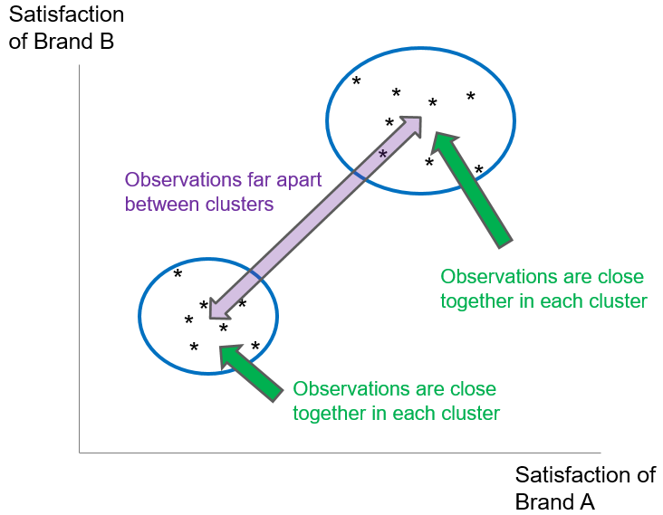
Intuition of K-Means Clustering
We want members in a cluster to be ‘close’ to each other, and clusters to be far apart from each other.

Slide 29
K-Means Clustering Process
The process of K-Means clustering contains five main steps:
Select K observations randomly as initial cluster centroids.
Compute the distance of each object to the centroid.
Assign each object to the nearest centroid based on the distance computed. Objects assigned to the same centroid form a cluster.
Recompute the centroid for each cluster using the objects in it. Restart iteration from Step 2.
Iteration stops when the centroids remain unchanged, or a specified number of iterations has been performed.

Slide 30
K-Means Properties
The Euclidean distance is preferred in general when computing the distance between an object to the centroids.
The Euclidean distance is measured by the sum of the squared differences between the values of some selected clustering criteria.
After the clustering process, ensure the insights created by the resulting clusters. A good clustering solution allows clear description of the cluster profile.
Evaluate the quality of clustering solutions by cohesion, separation and parsimony.

Slide 31
Fitting K-Means Clustering by Scikit-Learn
In scikit-learn, all algorithms are controlled and executed by the estimator.
Adjust the parameters for the modelling process in the syntax of the estimator declaration.
In K-Means Clustering, the estimator is called KMeans. And it can be imported from the cluster module of the scikit-learn package.
Initiate the KMeans estimator first and adjust the estimation parameters according to the individual needs.
from sklearn.cluster import KMeans
km_Object = sklearn.cluster.KMeans(n_clusters = 8, init = "k-means++", n_init = 10, max_iter = 300, tol = 0.0001, precompute_distances = "auto", random_state = None)

Slide 32
Parameters of the K-Means Estimator
Below is a list of the parameters of the K-Means estimator.
(Source: https://scikit-learn.org/stable/modules/generated/sklearn.cluster.KMeans. ‌html)
Parameter | Value Type
n_clusters (Default: 8) | Integer
init (Default : "k-means++") | "k-means++", "random", callable, array-like of shape
n_init (Default: 10) | Integer
max_iter (Default: 300) | Integer
tol (Default: 1e-4) | Float
precompute_distances (Default: "auto") | "auto", True, False
random_state (Default: None) | Integer, RandomState instance, None

Slide 33
Fit K-Means Clustering
Perform K-Means clustering using the KMeans estimator.
X is a prepared DataFrame based on which the clusters are constructed.
With sample_weight we can pre-specify the weights for each observation in X. If it is set to None, all observations will be assigned equal weight.
The fitted estimator of the K-Means algorithm is saved in km_fit_Object.
km_fit_Object = km_Object.fit(X, sample_weight = None)

Slide 34
K-Means Clustering
Find the clusters for each observation in the original DataFrame using the fit_predict() function.
X contains the data for which the cluster prediction is calculated.
The output object here is an array with indices of the clusters to which each sample is assigned.
Use elbow method to determine the optimal number of clusters before the clustering algorithm starts.
km_pred_Object = km_Object.fit_predict (X, sample_weight = None)

Slide 35
Explore K-Means Clustering Models
Explore the characteristics of the clusters by looking at some statistics such as mean, min, max, etc. of the clustering criteria.
Cross-tabulate the clustering criteria and the cluster index to understand the features of the clusters.
If a clustering criteria variable is categorical, interpret the clusters based on the proportional distribution of the clusters in each category.
Create cross-tables with the crosstab() function:
Clustering criteria are usually listed in rows rather than in columns.
Cluster indices are placed as columns since the cluster number is limited.
pd.crosstab(index = criteria_var, columns = cluster_index, normalize = "index", margin = True)

Slide 36
Activity
Run through the SU5 Clustering Notebook

Slide 37
Decision Trees (This section is optional)

Slide 38
Introduction to Decision Trees (I)
Decision trees split a sample to reach certain decision points based on some criteria. It is therefore a sample classification technique.
Each decision point is called a node and represents a subset of the sample.
Nodes split from a superordinate node are called the child node while the origin node is called the parent node.
A child node with no further subdivisions or splitting is called a leaf node.
The decision tree algorithm predicts the individual classification based on the input variables and the value of the target variable at the same time.
These rules of decision form the resulting model which can be illustrated by a tree-like structure graphically.

Slide 39
Introduction to Decision Trees (II)
Decision tree model illustrates the complex relationship between the target variable and the input variables rather well.
The importance of the input variables in the decision rules is reflected in the decision tree. Higher up variables are more important.
The value of a leaf node is the prediction of the target variable for those observations classified in it.
If the target variable is categorical, the predicted value will be the mode. If it is numeric, the value will be the mean.

Slide 40
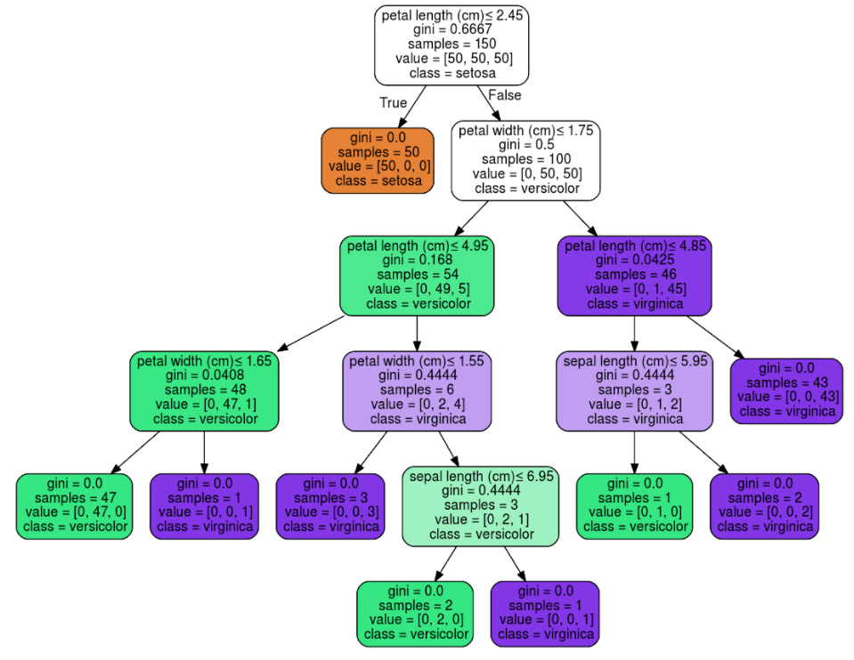
Example of Decision Tree
Source: https://scikit-learn.org/stable/modules/tree.html
Root node; the most important feature
In total, we have 9 leaf nodes (nodes in the red rectangles)

Slide 41
Algorithm of Constructing Decision Trees (I)
The most common algorithms for constructing decision trees are CHAID (chi-square automatic interaction detection), C5.0 (a proprietary algorithm) and CART (classification and regression tree).
The estimators DecisionTreeClassifier and DecisionTree-Regressor of scikit-learn use an optimised version of CART.
The CART algorithm can create classification and regression trees.
Regression trees estimate values of continuous target variables, while classification trees predict outcomes of categorical target variables.
CART splits the tree into two sub-samples at every decision point based on the input variables.
The splitting process terminates once certain stopping criteria are fulfilled.

Slide 42
Algorithm of Constructing Decision Trees (II)
The sample subset at each node become more homogeneous as the split process advances.
The homogeneity of each subset reflects the split quality from a parent node to its child nodes.
In classification tree, the homogeneity is measured by Gini and Entropy.
In regression tree, the impurity is measured by the sum of squared error (SSE).
In both options, the split with the highest reduction of impurity or highest homogeneity in the child nodes will be chosen.

Slide 43
Algorithm of Constructing Decision Trees (III)
Two possibilities to stop the CART algorithm:
no or little improvement of impurity detected after a new split
Gini/SSE drops below a threshold
Low Gini or SSE indicates rather homogeneous nodes, another split would not decrease the impurity significantly.
High thresholds: oversimplified trees. Low thresholds: overcomplicated trees.
a pre-specified depth (number of splits) of the tree is reached
control tree size without oversimplifying or overcomplicating it.
Set a lower bound of observations in the nodes.

Slide 44
Evaluation of Decision Trees (I)
Evaluate the performance of a decision tree by examining its fit on available data.
For classification trees, use confusion matrix
Summarise correct and incorrect classifications.
The larger the proportion of identical predicted and observed classifications, the more accurate is the decision tree model.
For regression trees, use Root-Mean-Square-Error (RMSE)
Average deviance of all predicted values from the observed values.
The lower the deviance, the closer are the predictions to the actual values, and the better is the model.

Slide 45
Evaluation of Decision Trees (II)
Evaluate also the performance of a decision tree by its prediction accuracy on unseen data.
Partition the original dataset randomly into a training and a testing dataset.
The decision tree as a predictive model is evaluated by its ability to apply what it has “learned” from the training data to the testing data.
If the prediction accuracy of the model on the training data is much higher than the testing data, the model tends to be overfitted.

Slide 46
Decision Tree Estimators (I)
Import the sklearn.tree module in the first place.
Initiate the DecisionTreeClassifier estimator for classification tree:
To fit a regression tree, declare the DecisionTreeRegressor estimator.
“…” indicates the parameters of the estimator that control the fitting of the decision trees.
from sklearn import tree
tree_Object = sklearn.tree.DecisionTreeClassifier(…)
tree_Object = sklearn.tree.DecisionTreeRegressor(…)

Slide 47
Decision Tree Estimators (II)
Here is a list of the parameters of the DecisionTreeClassifier and DecisionTreeRegressor estimators.
The main differences between them are the parameter criterion and the availability of the parameter class_weight.
(Source: https://scikit-learn.org/stable/modules/generated/sklearn.tree.DecisionTreeClassifier.html, https://scikit-learn.org/stable/modules/generated/sklearn.tree.DecisionTreeRegressor.html)
Parameter | Value Type
criterion (Default: "gini" for classification, "mse" for regression) | Classification: "gini", "entropy" Regression: "mse", "friedman_mse", "mae", "poisson"
splitter (Default: "best") | "best", "random"
max_depth (Default: None) | Integer
min_samples_split (Default: 2) | Integer or float
min_samples_leaf (Default: 1) | Integer or float

Slide 48
Decision Tree Estimators (III)
(Source: https://scikit-learn.org/stable/modules/generated/sklearn.tree.DecisionTreeClassifier.html, https://scikit-learn.org/stable/modules/generated/sklearn.tree.DecisionTreeRegressor.html)
Parameter | Value Type
min_weight_fraction_leaf (Default: 0.0) | Float
max_features (Default: None) | Integer, float, "auto", "sqrt", "log2"
random_state (Default: None) | integer, RandomState instance, None
max_leaf_nodes (Default: None) | Integer
min_impurity_decrease (Default: 0.0) | Float
min_impurity_split (Default: 0) | Float
class_weight (Default: None) Note: Classification trees only. | dictionary, list of dictionaries, "balanced"

Slide 49
Fit Decision Trees
Fit decision trees on a prepared training DataFrames by .fit().
The .fit() method applies to both DecisionTreeClassifier and DecisionTreeRegressor.
Predict the classification of the testing dataset by .predict().
The returned object is a NumPy array with the predicted target values of every observation in the testing dataset.
tree_fit_Object = tree_Object.fit(X_train, y_train, sample_weight = None)
tree_Pred_Object = tree_Object.predict(X_test)

Slide 50
Evaluate Decision Trees
One way to evaluate the performance of a decision tree is the confusion matrix.
The confusion matrix can be computed by confusion_matrix().
Accuracy, precision, and recall scores can also assess the predictive performance of a decision tree.
These scores are useful in examining binary classification target variables.
metrics.confusion_matrix(target_var, tree_pred_Object)
metrics.accuracy_score(target_var, tree_pred_Object)
metrics.precision_score(target_var, tree_pred_Object)
metrics.recall_score(target_var, tree_pred_Object)

Slide 51
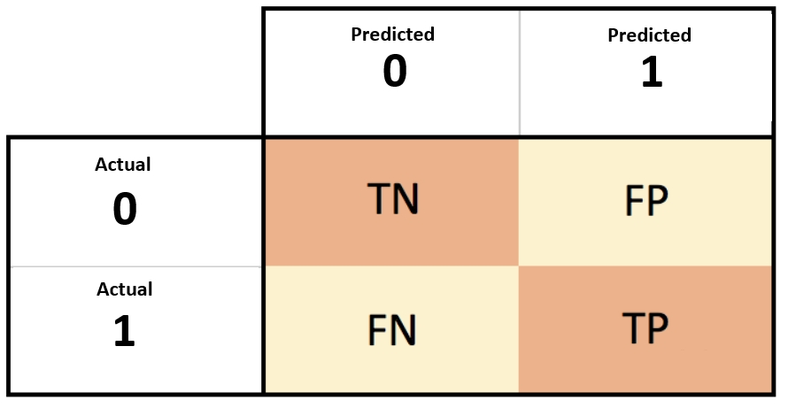
Example of a Confusion Matrix
Suppose we fit a decision tree to predict if a consumer buys a coke
target: ‘1’ for buy a coke; ‘0’ for did not buy a coke.
predicted not to buy coke, and actually did not buy coke
True Negative
False Positive
20 observations
30 observations
False Negative
True Positive
10 observations
40 observations
predicted not to buy coke, but actually buys coke
Predicted to buy coke, and actually buys coke

Slide 52
3 Scores from Confusion Matrix
Accuracy Score = (TN + TP) / (TN + FP + TP + FN) = (20 + 40)/100 = 0.60
Proportion of observations correctly classified in the sample
Precision Score = TP / (TP + FP) = 40 / (30 + 40) = 4/7 = 0.57
Proportion of observations correctly classified in the subsample which is predicted to buy coke
Recall Score = TP / (TP + FN) = 40 / (40 + 10) = 4/5 = 0.80
Proportion of observations correctly predicted to buy coke in the subsample that actually bought coke

Slide 53
Plot Decision Trees (I)
Decision tree plot is an important tool to understand and to evaluate its performance.
The plot can be generated by the plot_tree() function of the tree module conveniently.
The plot_tree() function can also be combined with the matplotlib options to optimise the output of the tree.
tree.plot_tree(decision_tree, max_depth = None, feature_names = None, class_names = None, label = "all", filled = False, impurity = True, node_ids = False, proportion = False, rounded = False, precision = 3, ax = None, fontsize = None)

Slide 54
Plot Decision Trees (II)
Here is a list of the parameters of the plot_tree() function.
(Source: https://scikit-learn.org/stable/modules/generated/sklearn.tree.plot_tree.html)
Parameter | Value Type
decision_tree (No default value) | Decision tree object
max_depth (Default: None) | Integer
feature_names (Default: None) | List of strings
class_names (Default: None) | List of strings or Boolean
label (Default: "all") | "all", "root", "none"
filled (Default: False) | Boolean
impurity (Default: True) | Boolean

Slide 55
Plot Decision Trees (III)
(Source: https://scikit-learn.org/stable/modules/generated/sklearn.tree.plot_tree.html)
Parameter | Value Type
node_ids (Default: False) | Boolean
proportion (Default: False) | Boolean
rounded (Default: False) | Boolean
precision (Default: 3) | Integer
ax (Default: None) | matplotlib axes
fontsize (Default: None) | Integer

Slide 56
Activity
Run through the SU5 Decision Tree Notebook

Slide 57
Discussion
Name all the main differences between classification trees and regression trees.
How do we judge a model with low prediction accuracy for testing data but high accuracy for training data?
Is it possible for a model to have low prediction accuracy for training data, but high accuracy for testing data?

